Slide 1
工作汇报
2018年11月14日

Slide 2
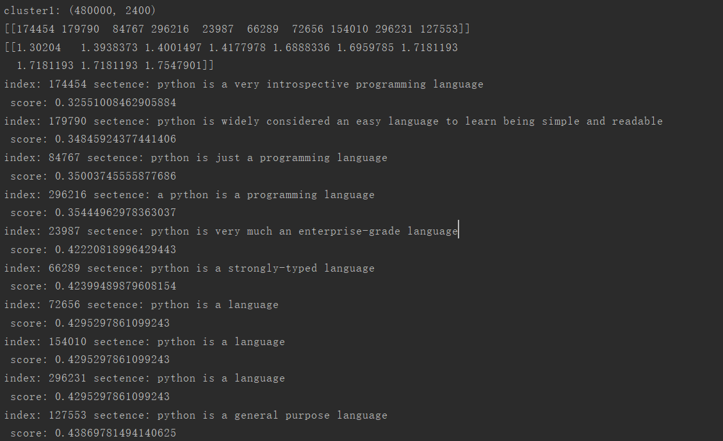
python is a widely used programming language
Notes:
采用不同的特征表达形式可以构造出不同的滤波组

Slide 3
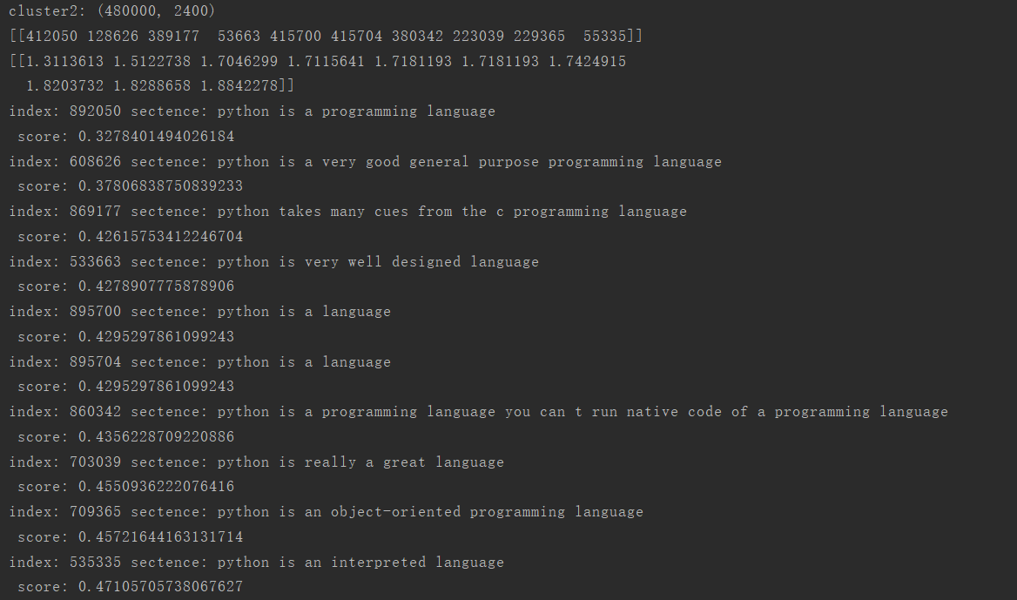
python is a widely used programming language
Notes:
采用不同的特征表达形式可以构造出不同的滤波组

Slide 4
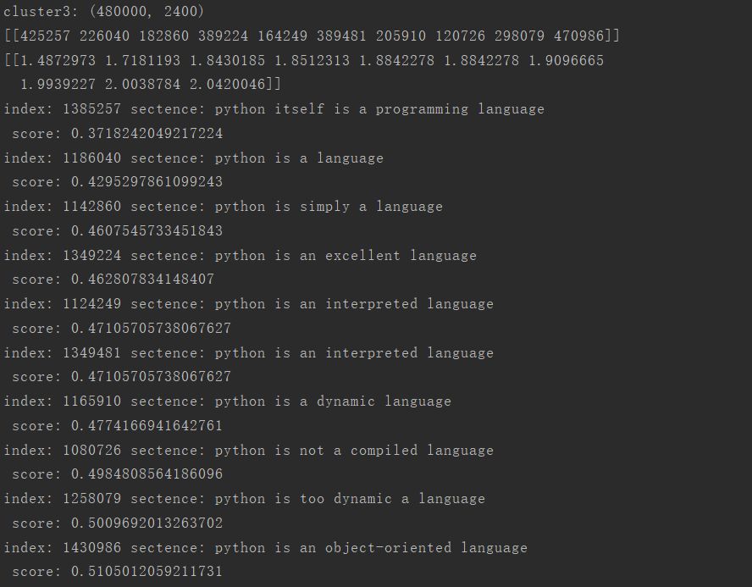
python is a widely used programming language
Notes:
采用不同的特征表达形式可以构造出不同的滤波组

Slide 5
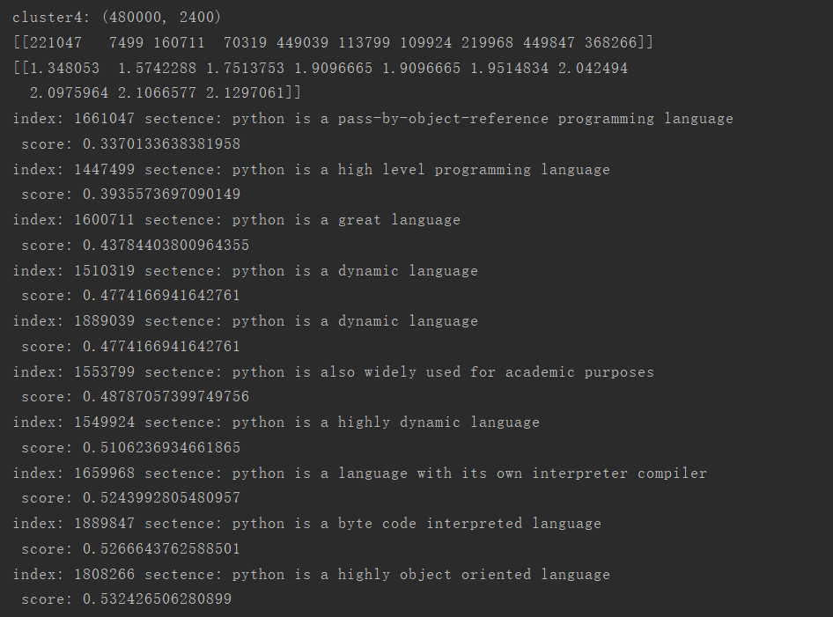
python is a widely used programming language
Notes:
采用不同的特征表达形式可以构造出不同的滤波组

Slide 6
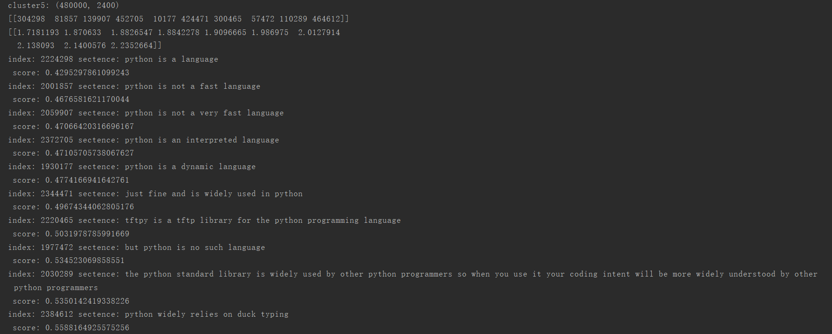
python is a widely used programming language
Notes:
采用不同的特征表达形式可以构造出不同的滤波组

Slide 7
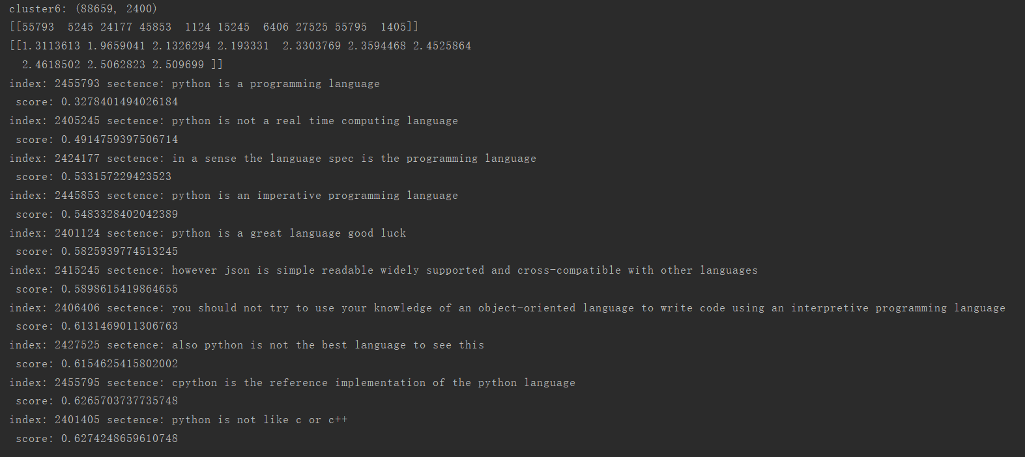
python is a widely used programming language
Notes:
采用不同的特征表达形式可以构造出不同的滤波组

Slide 8
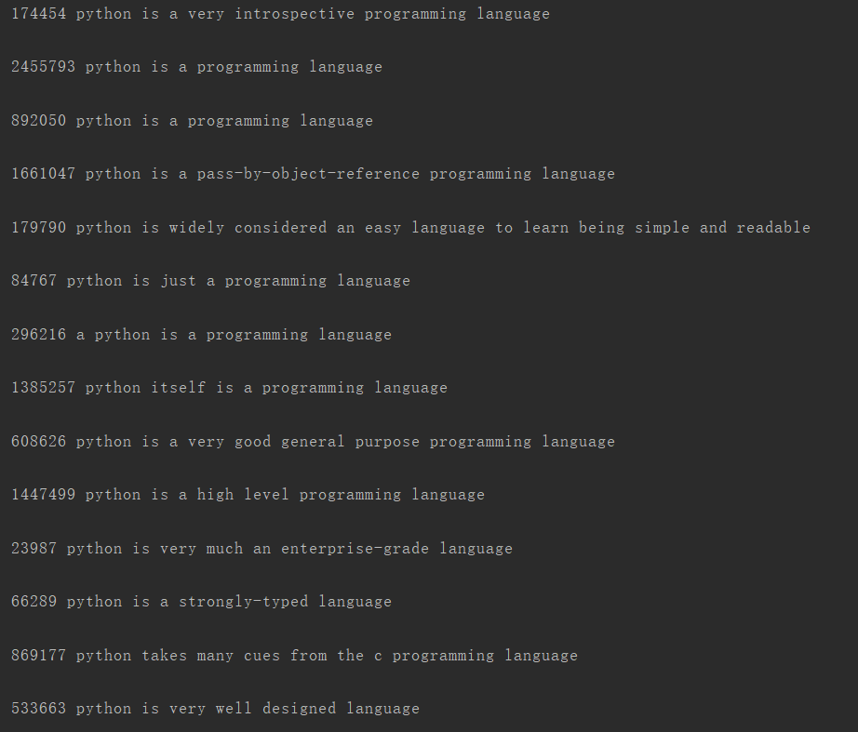
python is a widely used programming language
Sort：
Notes:
采用不同的特征表达形式可以构造出不同的滤波组

Slide 9
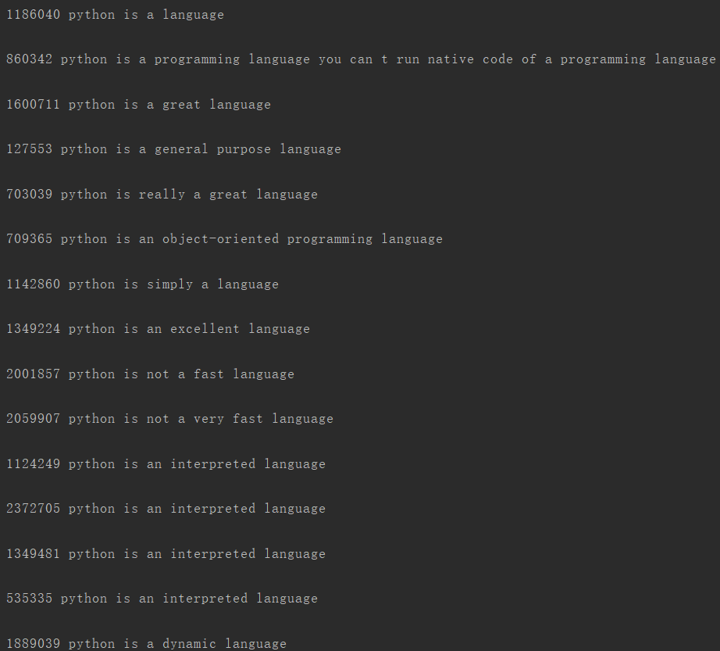
python is a widely used programming language
Notes:
采用不同的特征表达形式可以构造出不同的滤波组

Slide 10
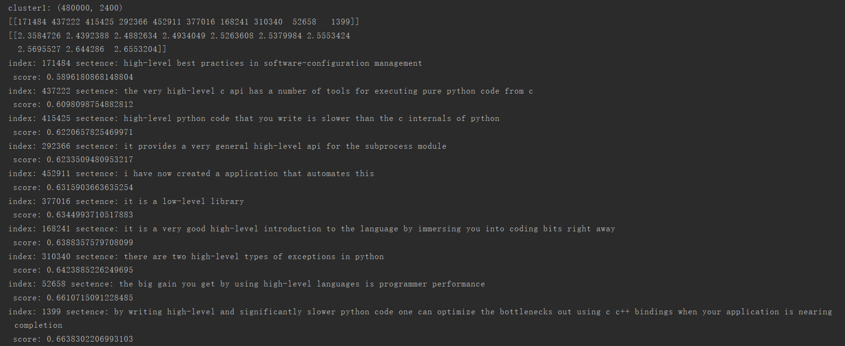
it is high-level python automates low-level operations such as memory management
Notes:
采用不同的特征表达形式可以构造出不同的滤波组

Slide 11
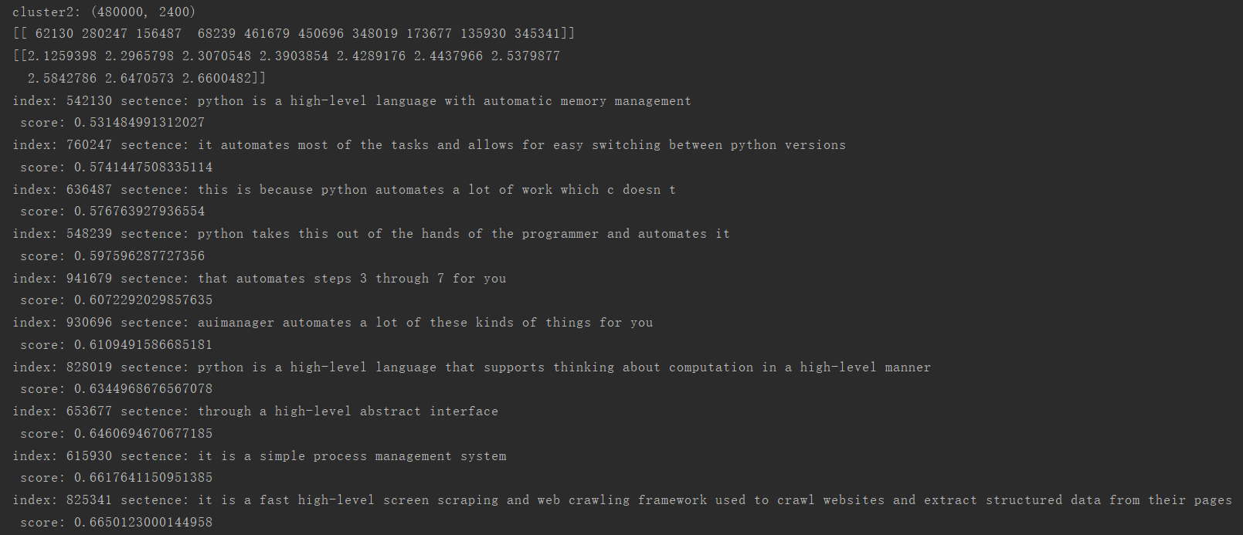
it is high-level python automates low-level operations such as memory management
Notes:
采用不同的特征表达形式可以构造出不同的滤波组

Slide 12
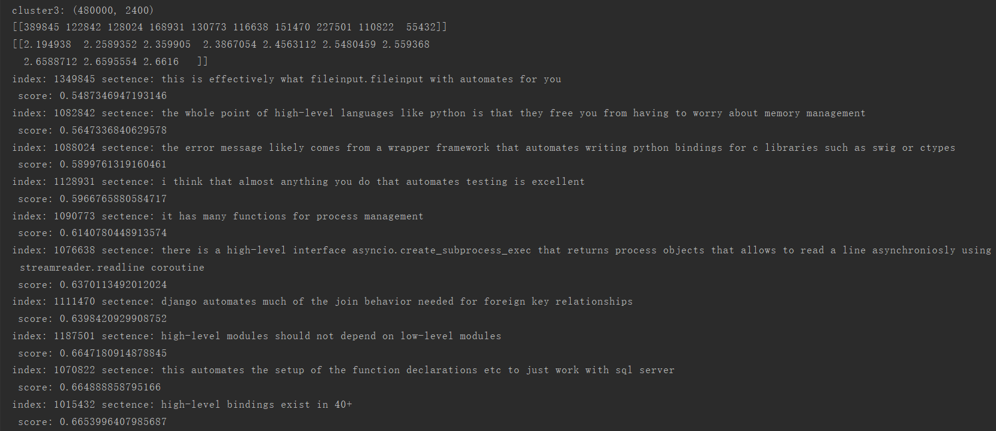
it is high-level python automates low-level operations such as memory management
Notes:
采用不同的特征表达形式可以构造出不同的滤波组

Slide 13
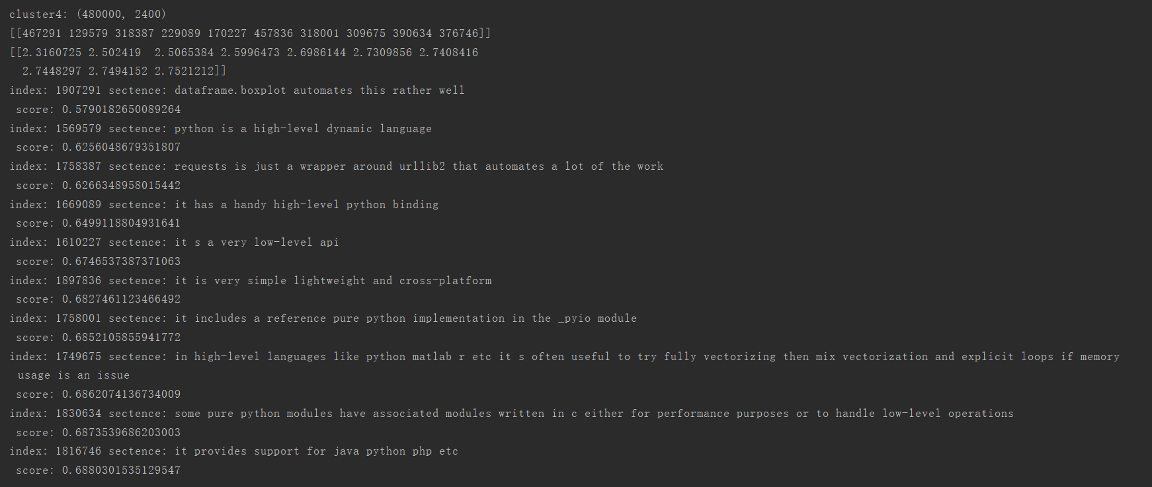
it is high-level python automates low-level operations such as memory management
Notes:
采用不同的特征表达形式可以构造出不同的滤波组

Slide 14
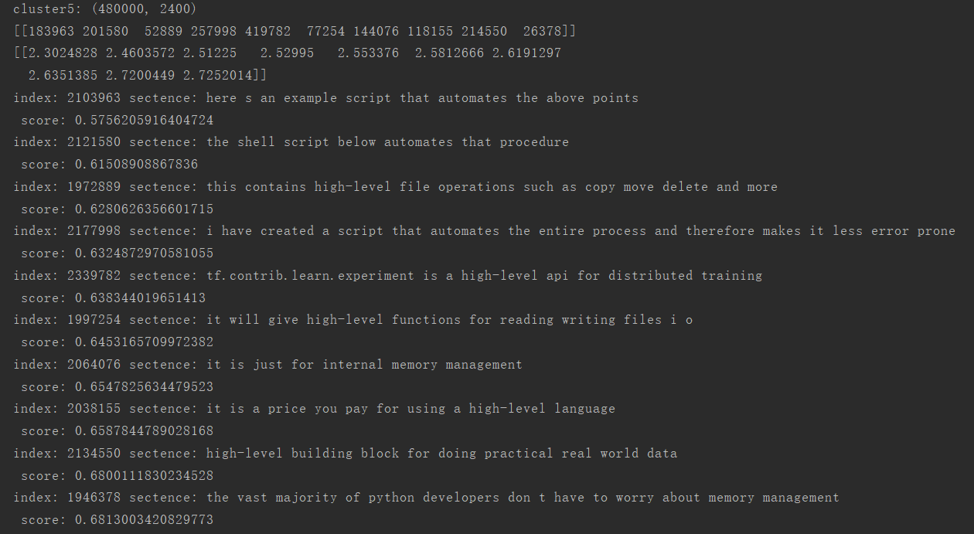
it is high-level python automates low-level operations such as memory management
Notes:
采用不同的特征表达形式可以构造出不同的滤波组

Slide 15
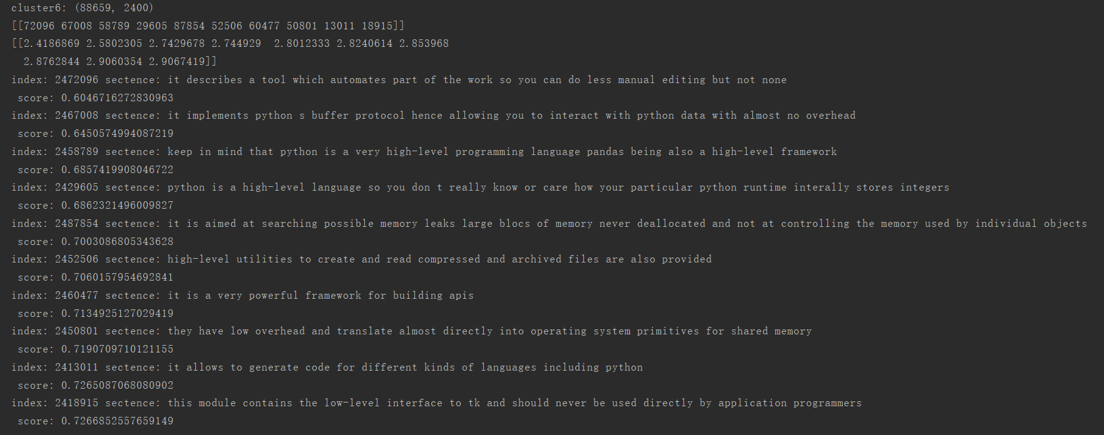
it is high-level python automates low-level operations such as memory management
Notes:
采用不同的特征表达形式可以构造出不同的滤波组

Slide 16
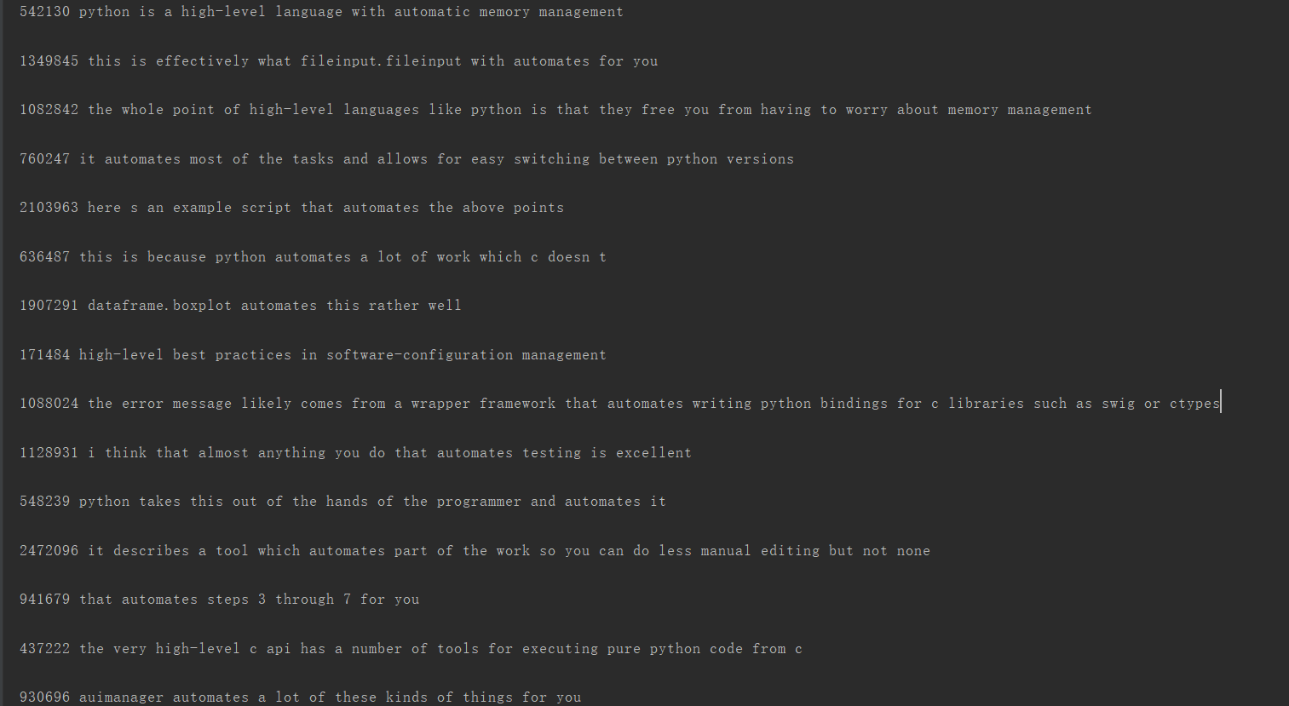
it is high-level python automates low-level operations such as memory management
Sort：
Notes:
采用不同的特征表达形式可以构造出不同的滤波组

Slide 17
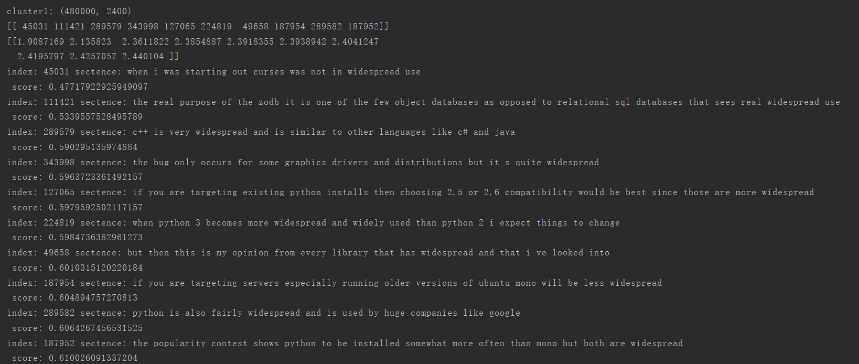
python 2.x is the legacy version although it still sees widespread use
Notes:
采用不同的特征表达形式可以构造出不同的滤波组

Slide 18
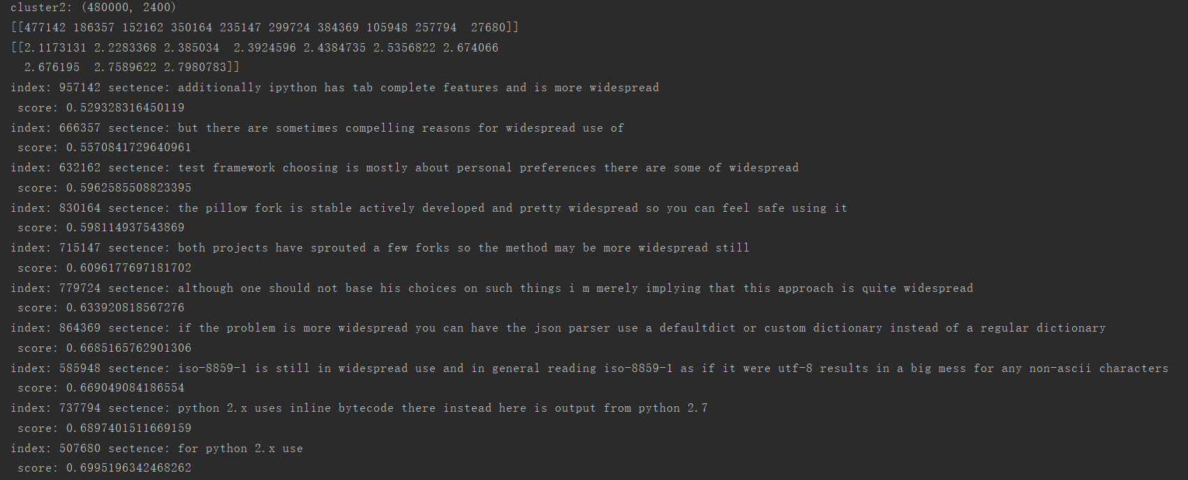
python 2.x is the legacy version although it still sees widespread use
Notes:
采用不同的特征表达形式可以构造出不同的滤波组

Slide 19
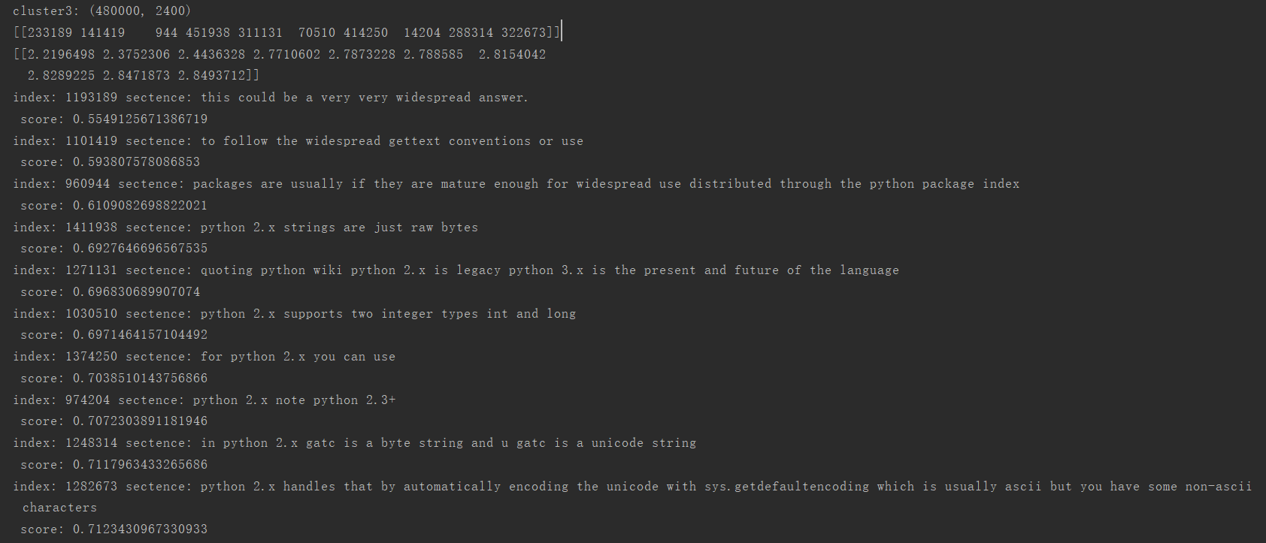
python 2.x is the legacy version although it still sees widespread use
Notes:
采用不同的特征表达形式可以构造出不同的滤波组

Slide 20
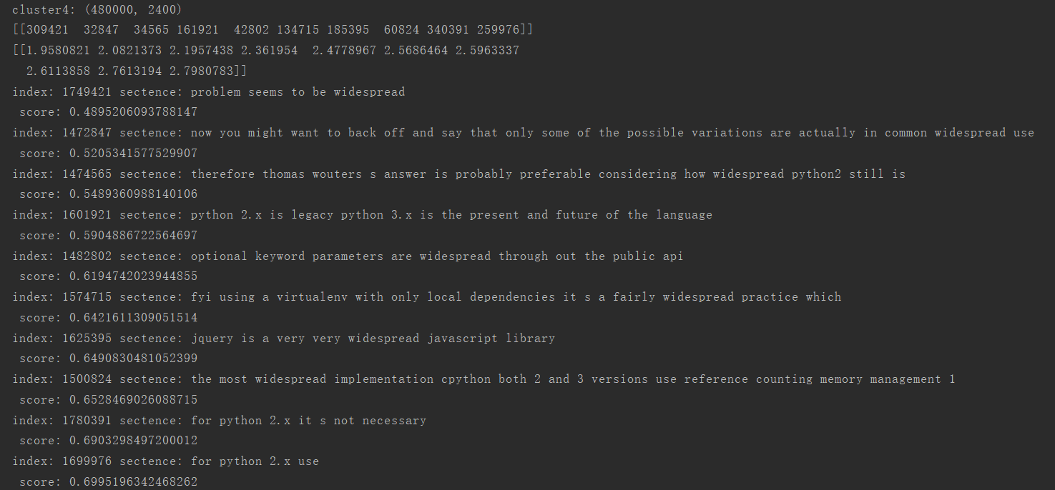
python 2.x is the legacy version although it still sees widespread use
Notes:
采用不同的特征表达形式可以构造出不同的滤波组

Slide 21
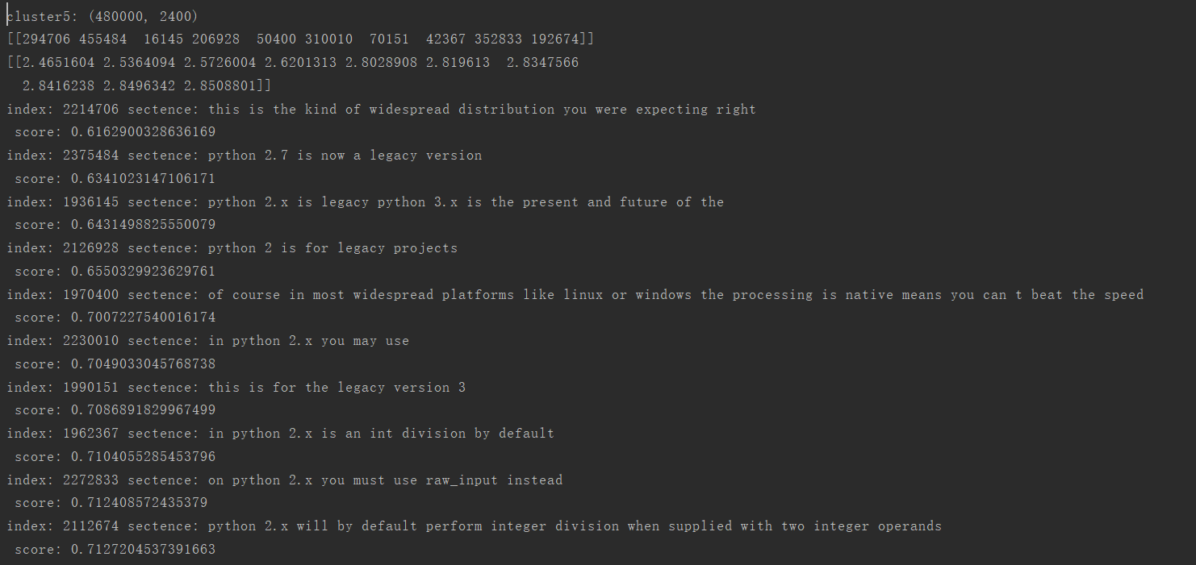
python 2.x is the legacy version although it still sees widespread use
Notes:
采用不同的特征表达形式可以构造出不同的滤波组

Slide 22
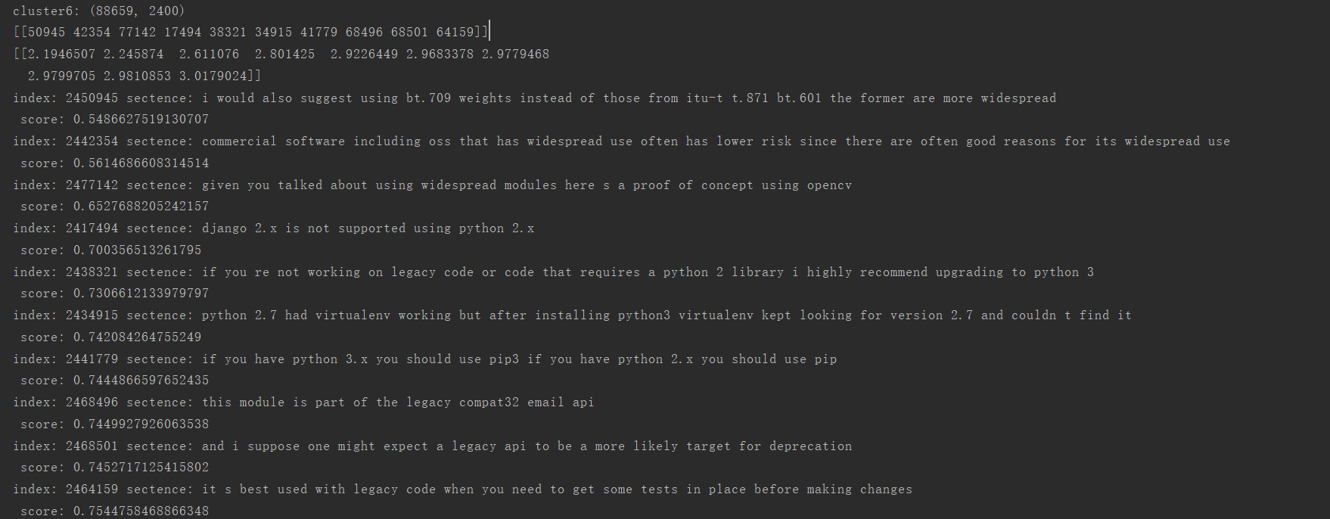
python 2.x is the legacy version although it still sees widespread use
Notes:
采用不同的特征表达形式可以构造出不同的滤波组

Slide 23
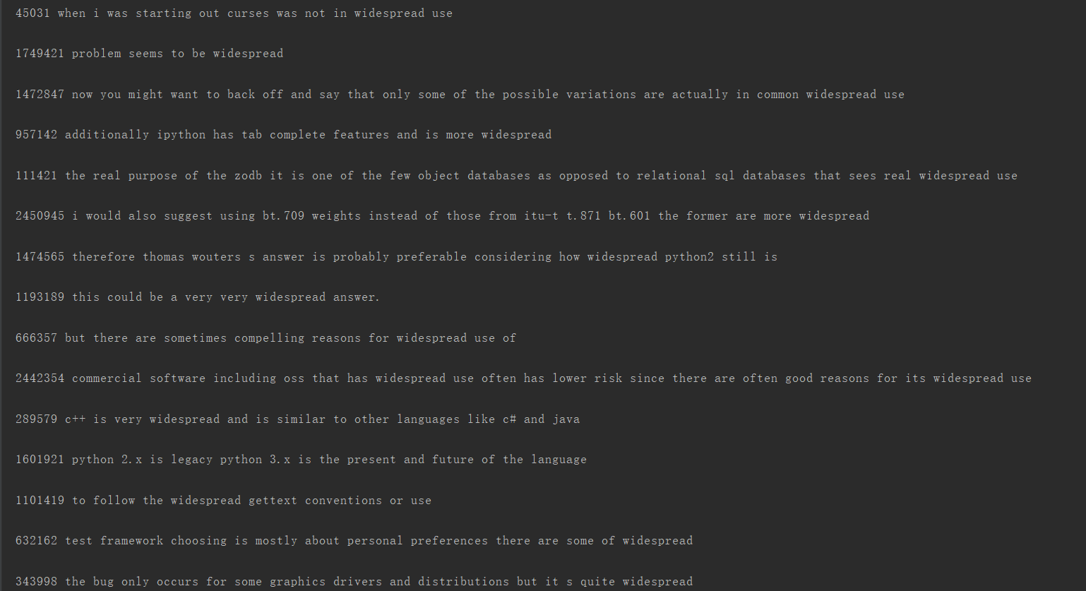
python 2.x is the legacy version although it still sees widespread use
Sort：
Notes:
采用不同的特征表达形式可以构造出不同的滤波组

Slide 24
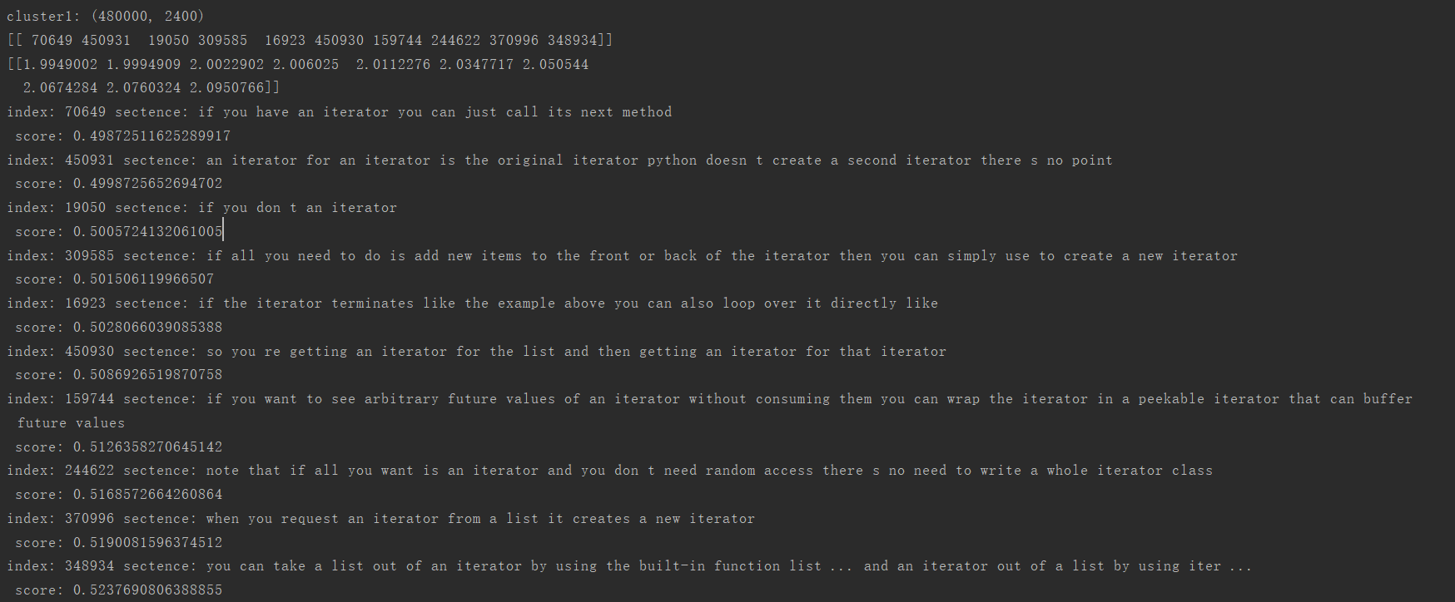
if an iterator does all the heavy lifting an empty for loop to just run the iterator can be useful
Notes:
采用不同的特征表达形式可以构造出不同的滤波组

Slide 25
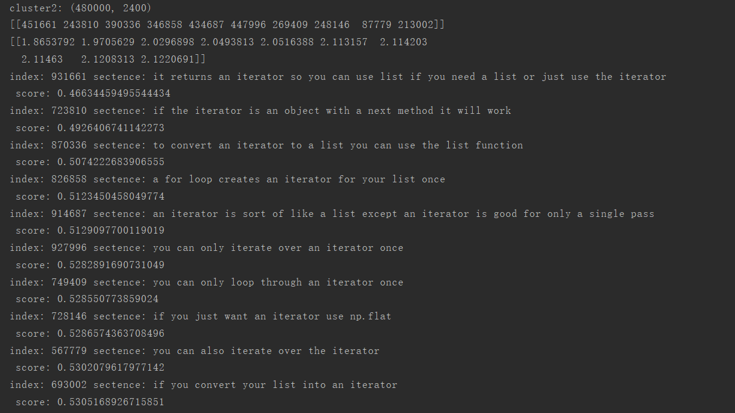
if an iterator does all the heavy lifting an empty for loop to just run the iterator can be useful
Notes:
采用不同的特征表达形式可以构造出不同的滤波组

Slide 26
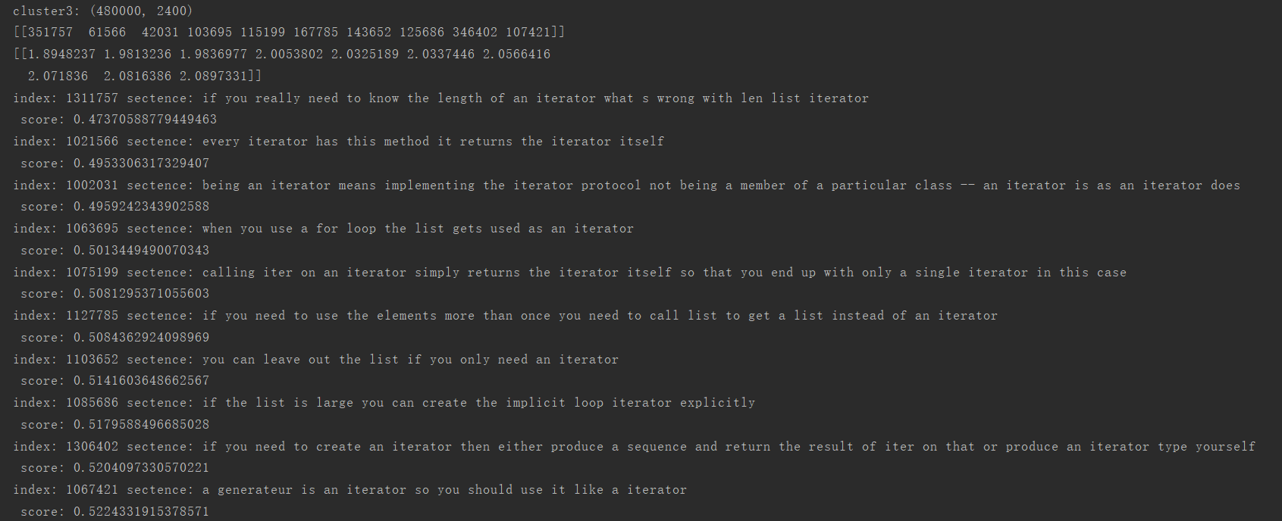
if an iterator does all the heavy lifting an empty for loop to just run the iterator can be useful
Notes:
采用不同的特征表达形式可以构造出不同的滤波组

Slide 27
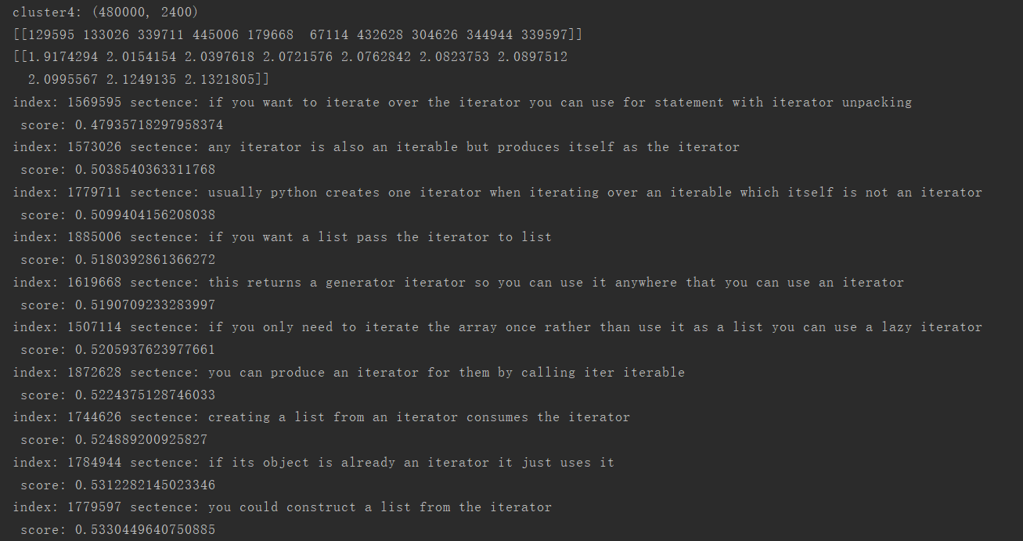
if an iterator does all the heavy lifting an empty for loop to just run the iterator can be useful
Notes:
采用不同的特征表达形式可以构造出不同的滤波组

Slide 28
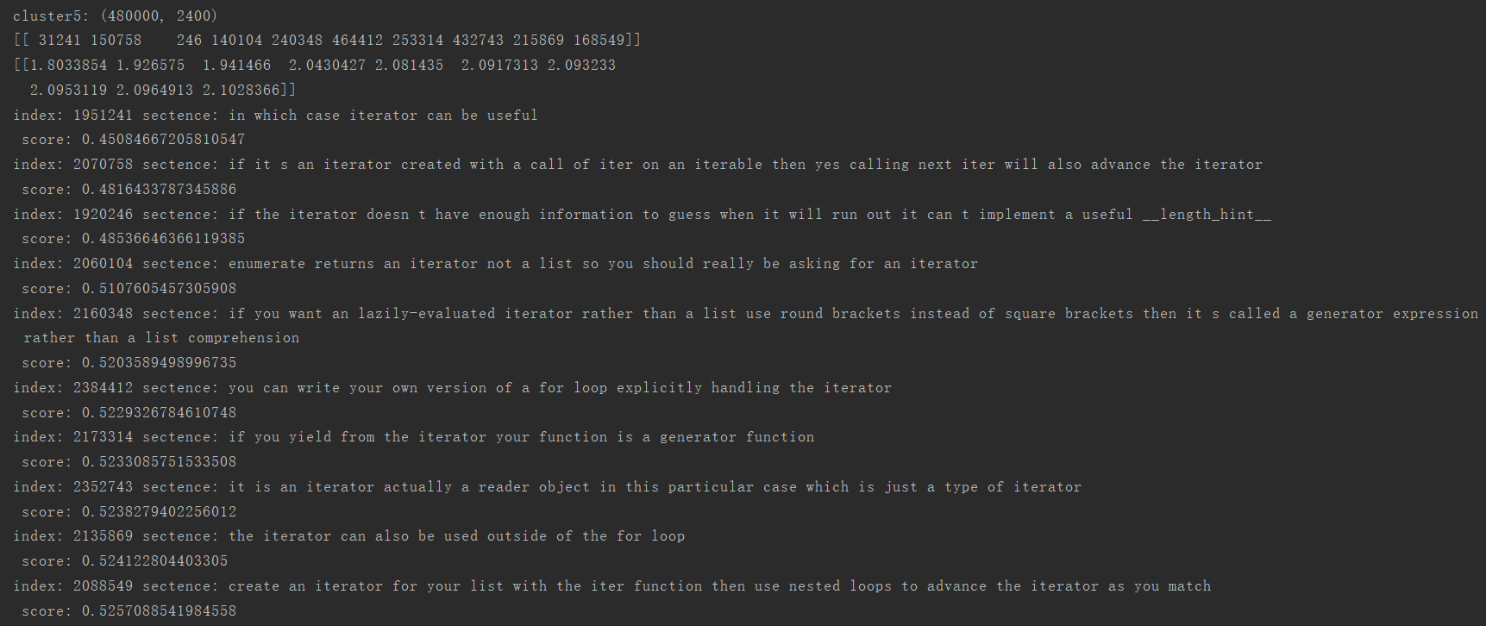
if an iterator does all the heavy lifting an empty for loop to just run the iterator can be useful
Notes:
采用不同的特征表达形式可以构造出不同的滤波组

Slide 29
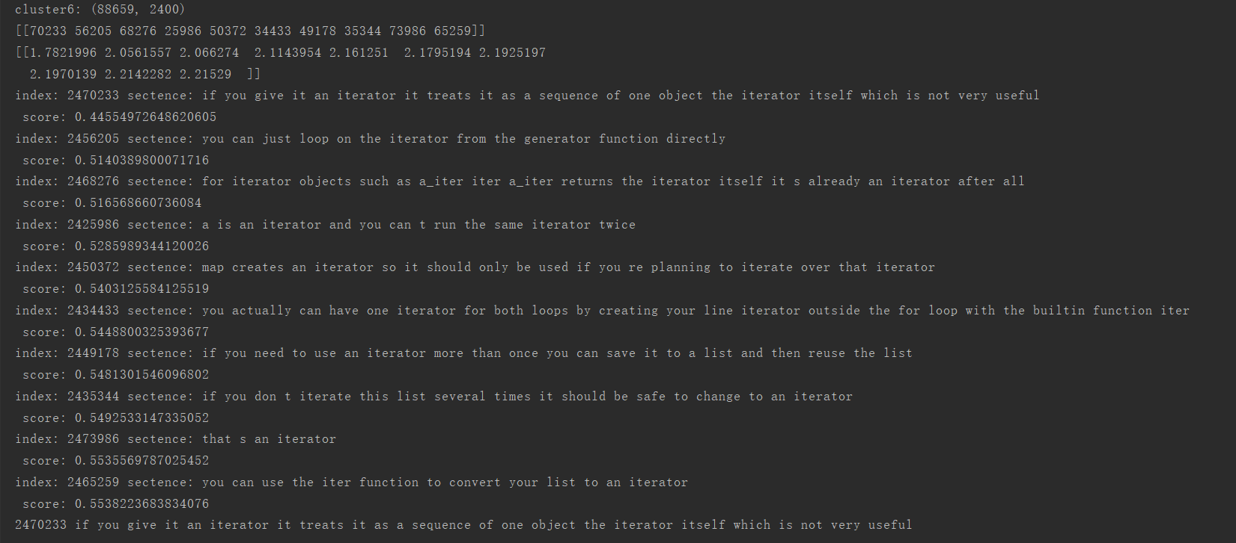
if an iterator does all the heavy lifting an empty for loop to just run the iterator can be useful
Notes:
采用不同的特征表达形式可以构造出不同的滤波组

Slide 30
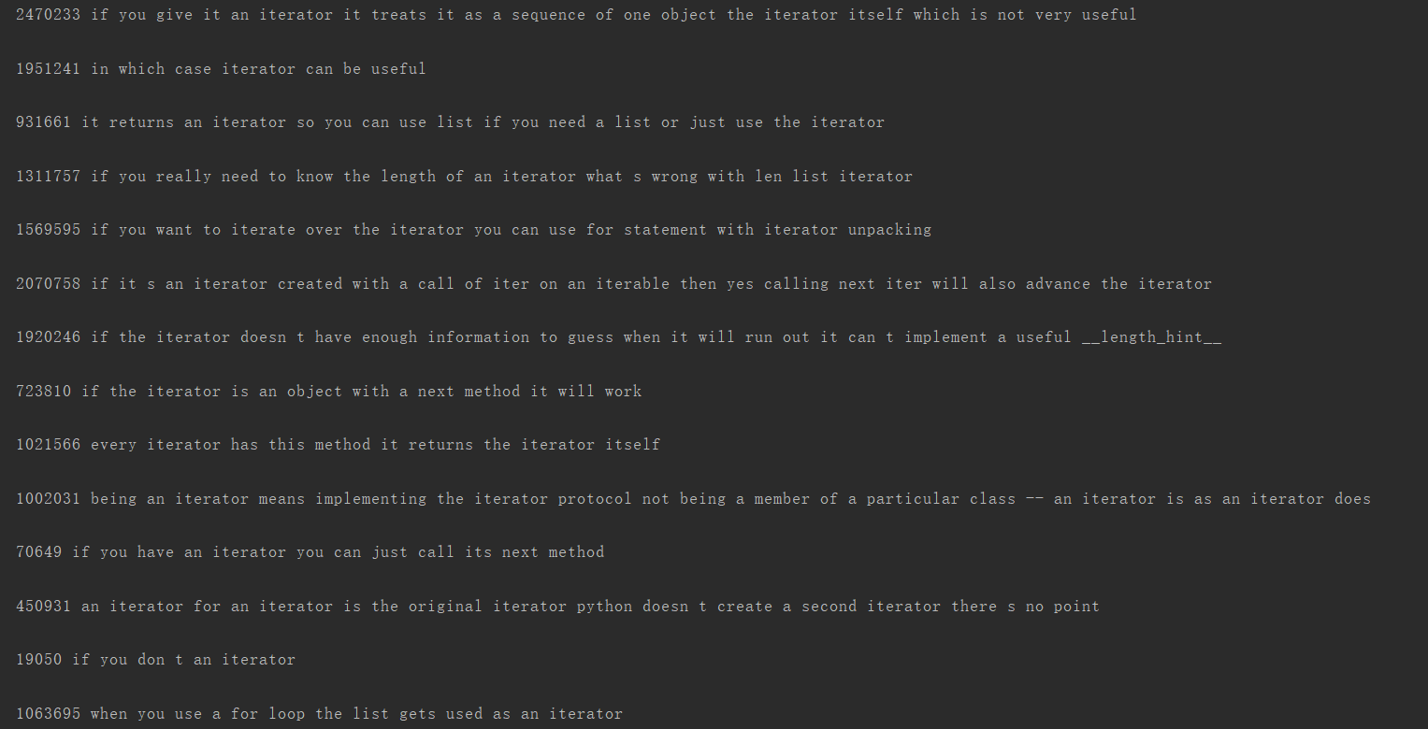
if an iterator does all the heavy lifting an empty for loop to just run the iterator can be useful
Sort：
Notes:
采用不同的特征表达形式可以构造出不同的滤波组

Slide 31
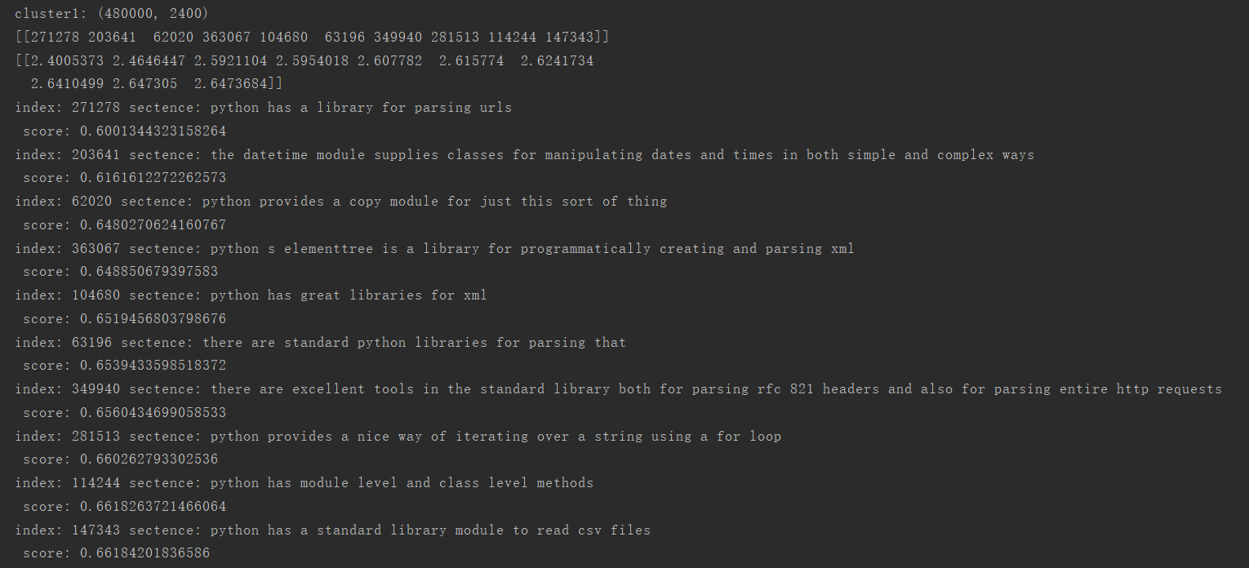
python provides both builtin methods and external libraries for creating modifying parsing and manipulating dates and times
Notes:
采用不同的特征表达形式可以构造出不同的滤波组

Slide 32
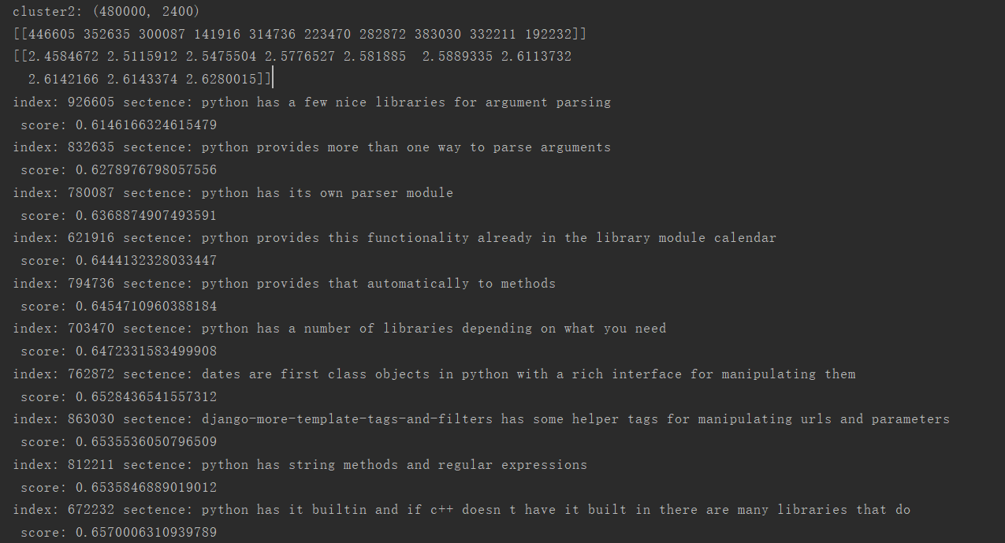
python provides both builtin methods and external libraries for creating modifying parsing and manipulating dates and times
Notes:
采用不同的特征表达形式可以构造出不同的滤波组

Slide 33
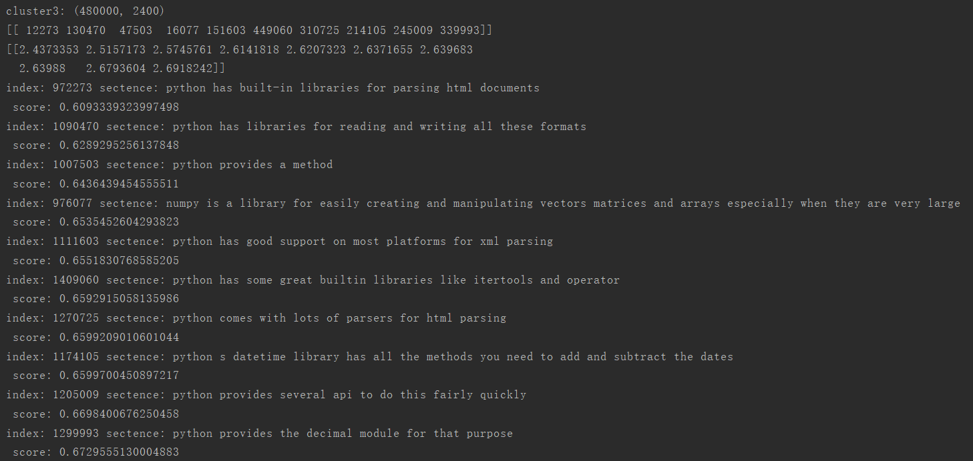
python provides both builtin methods and external libraries for creating modifying parsing and manipulating dates and times
Notes:
采用不同的特征表达形式可以构造出不同的滤波组

Slide 34
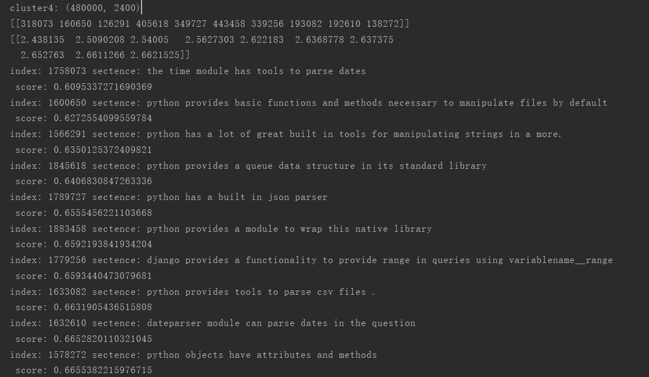
python provides both builtin methods and external libraries for creating modifying parsing and manipulating dates and times
Notes:
采用不同的特征表达形式可以构造出不同的滤波组

Slide 35
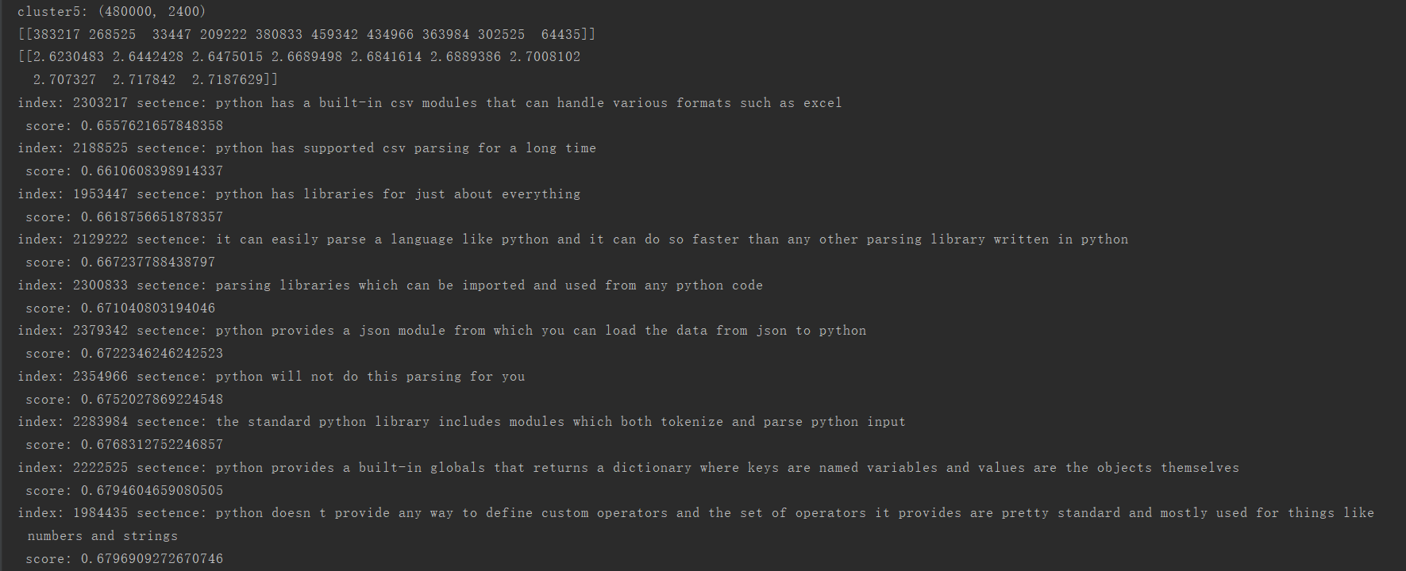
python provides both builtin methods and external libraries for creating modifying parsing and manipulating dates and times
Notes:
采用不同的特征表达形式可以构造出不同的滤波组

Slide 36
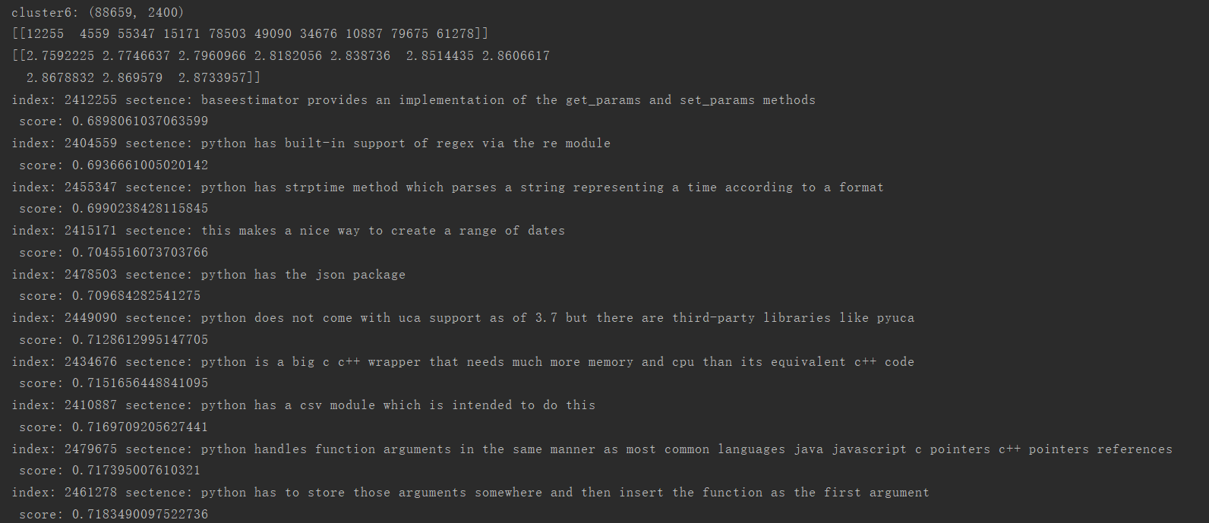
python provides both builtin methods and external libraries for creating modifying parsing and manipulating dates and times
Notes:
采用不同的特征表达形式可以构造出不同的滤波组

Slide 37
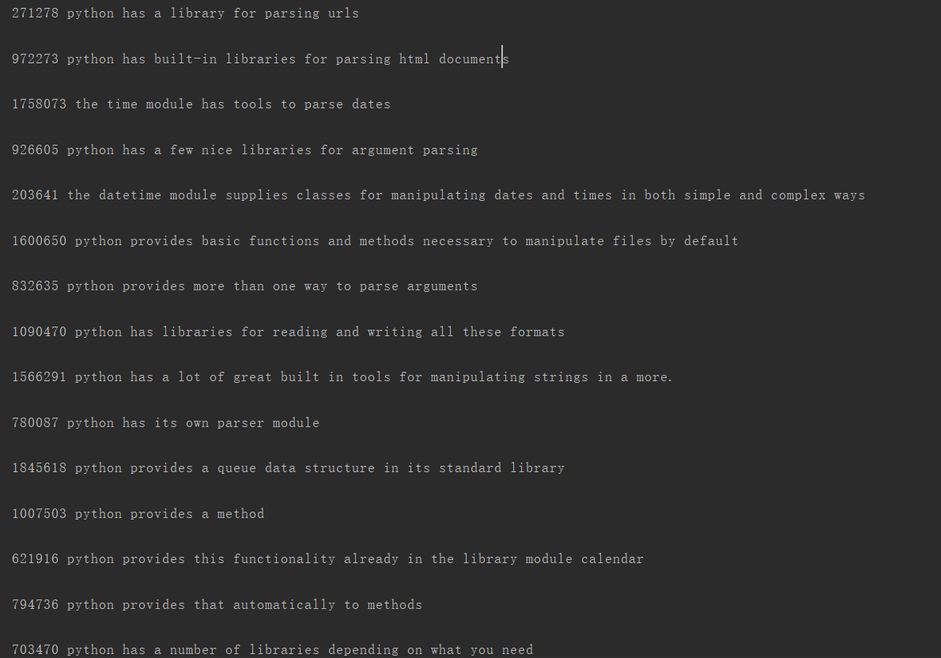
python provides both builtin methods and external libraries for creating modifying parsing and manipulating dates and times
Notes:
采用不同的特征表达形式可以构造出不同的滤波组

Slide 38
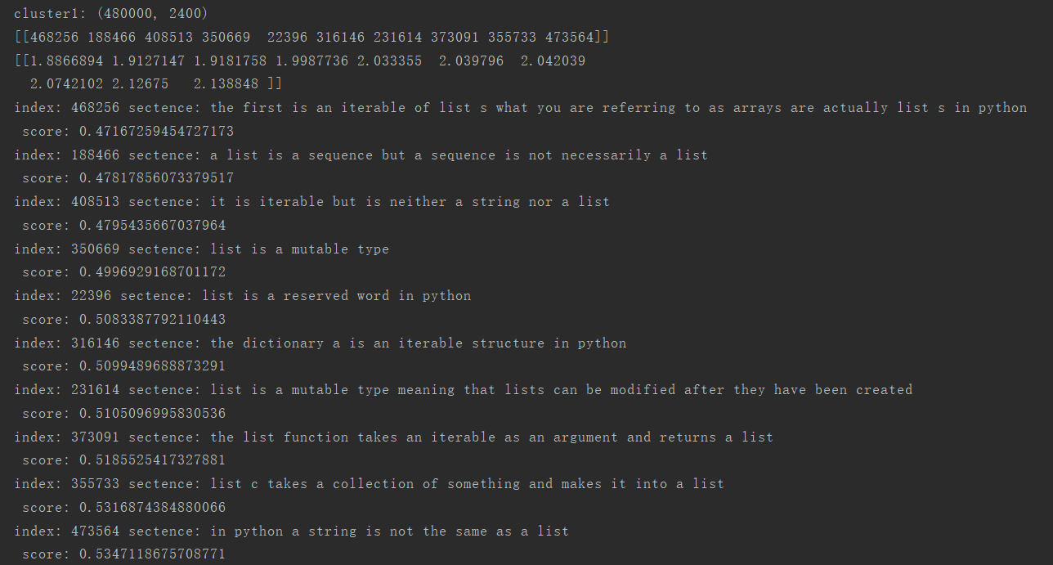
list is a particular type of iterable but it is not the only one that exists in python
Notes:
采用不同的特征表达形式可以构造出不同的滤波组

Slide 39
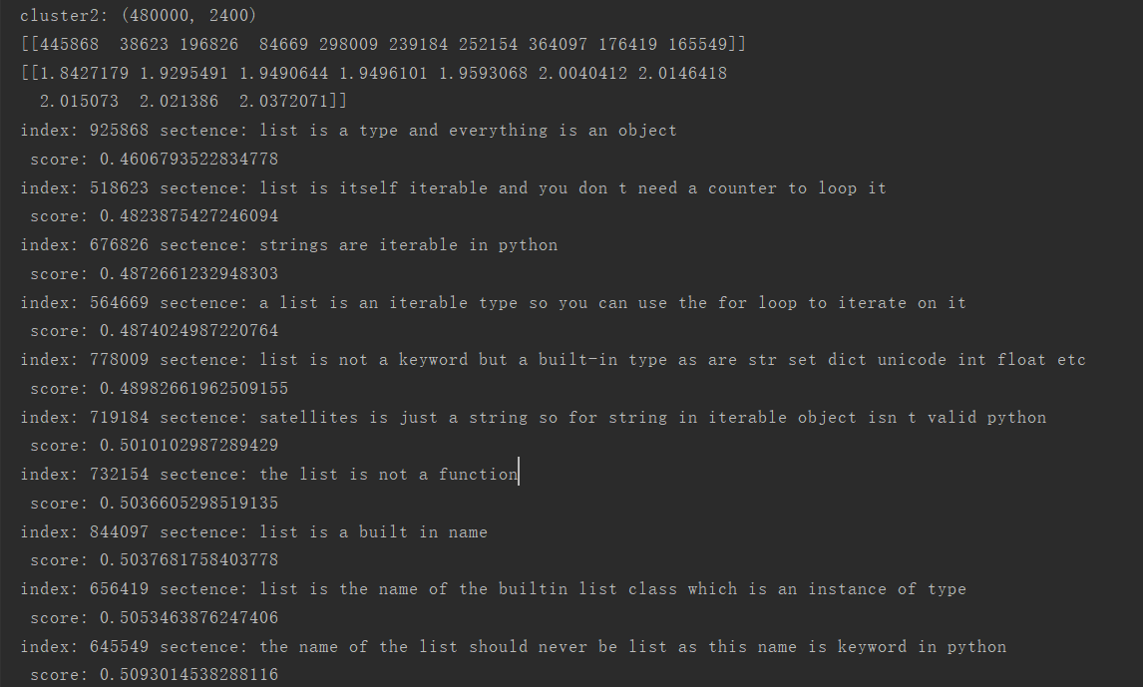
list is a particular type of iterable but it is not the only one that exists in python
Notes:
采用不同的特征表达形式可以构造出不同的滤波组

Slide 40
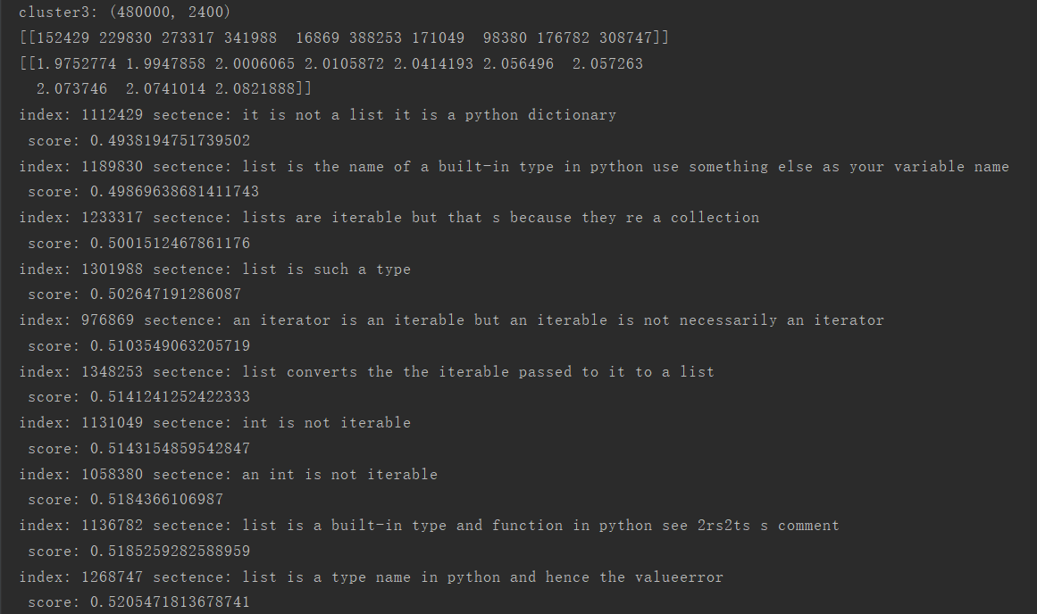
list is a particular type of iterable but it is not the only one that exists in python
Notes:
采用不同的特征表达形式可以构造出不同的滤波组

Slide 41
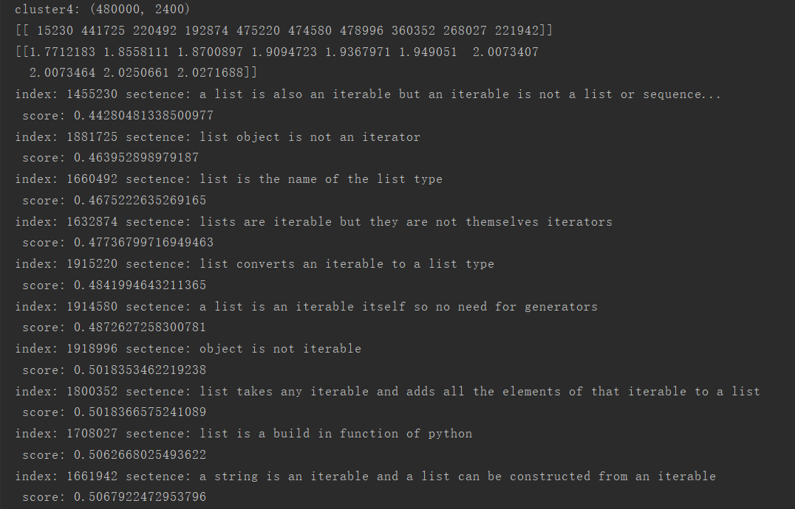
list is a particular type of iterable but it is not the only one that exists in python
Notes:
采用不同的特征表达形式可以构造出不同的滤波组

Slide 42
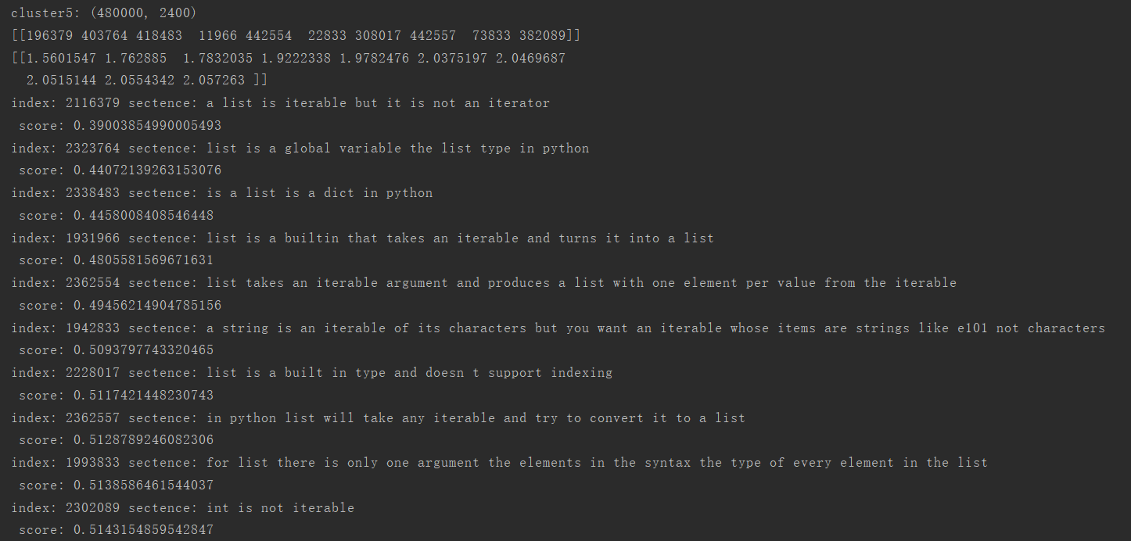
list is a particular type of iterable but it is not the only one that exists in python
Notes:
采用不同的特征表达形式可以构造出不同的滤波组

Slide 43
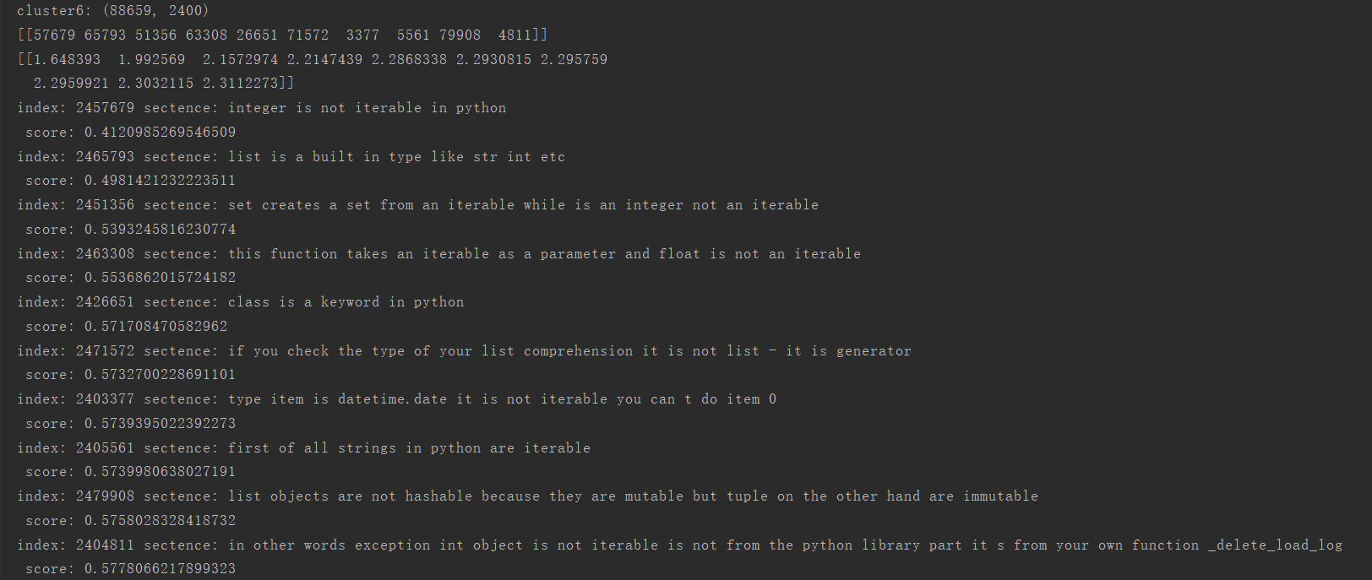
list is a particular type of iterable but it is not the only one that exists in python
Notes:
采用不同的特征表达形式可以构造出不同的滤波组

Slide 44
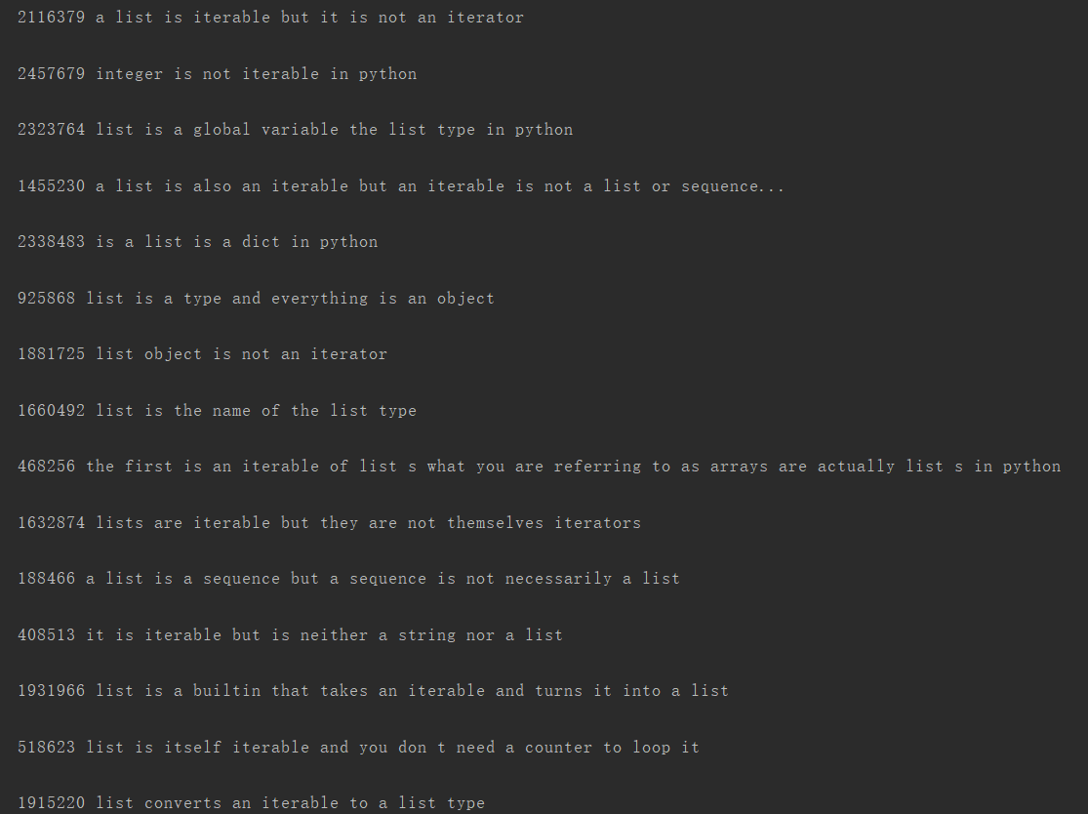
list is a particular type of iterable but it is not the only one that exists in python
Notes:
采用不同的特征表达形式可以构造出不同的滤波组

Slide 45
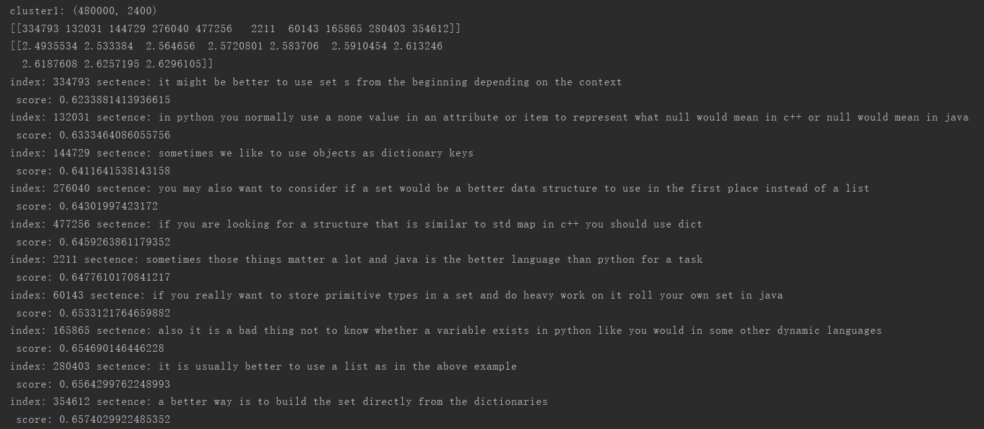
sometimes it will be better to use set tuple or dictionary list is the name given in python to dynamic arrays similar to from c++ or java
Notes:
采用不同的特征表达形式可以构造出不同的滤波组

Slide 46
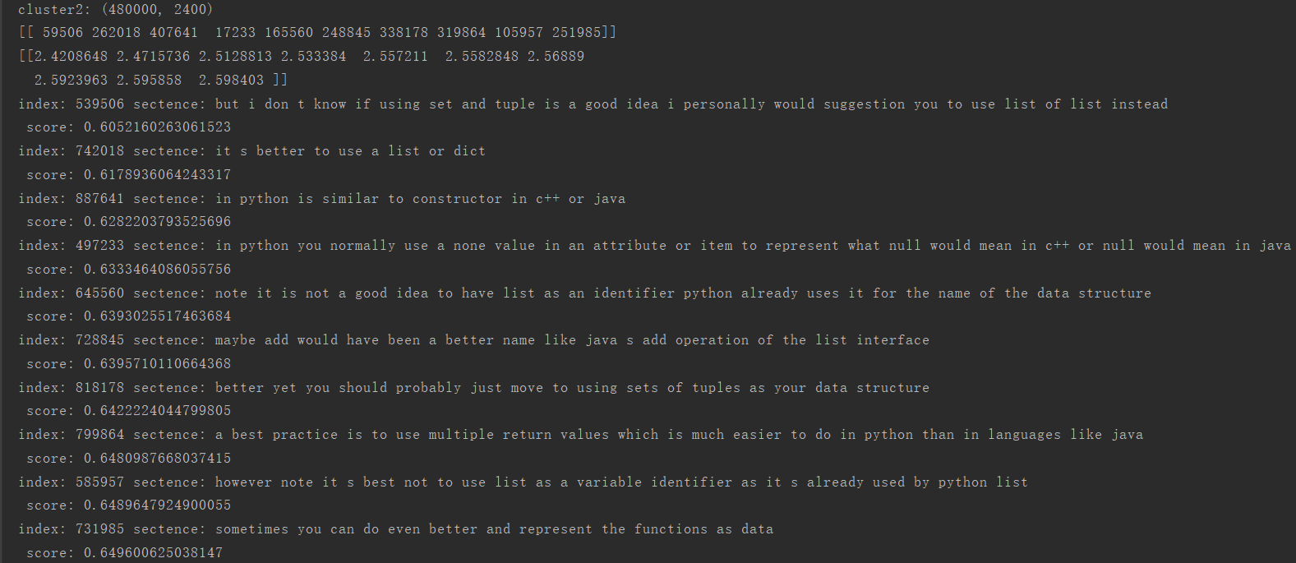
sometimes it will be better to use set tuple or dictionary list is the name given in python to dynamic arrays similar to from c++ or java
Notes:
采用不同的特征表达形式可以构造出不同的滤波组

Slide 47
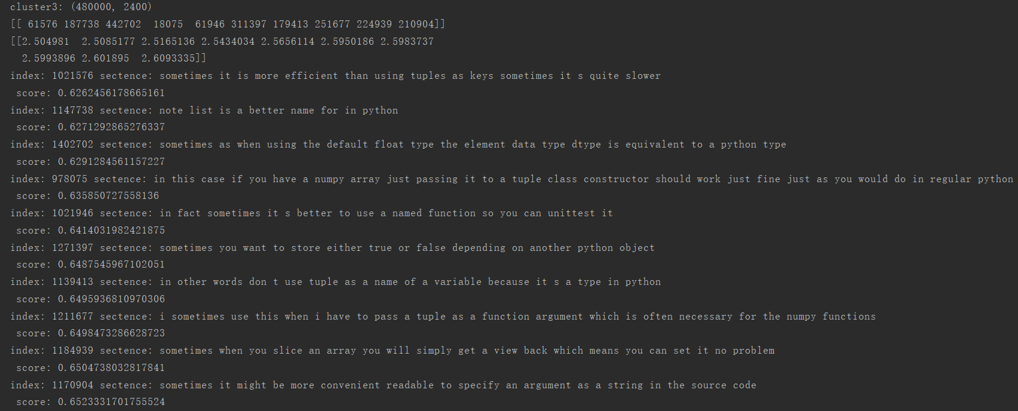
sometimes it will be better to use set tuple or dictionary list is the name given in python to dynamic arrays similar to from c++ or java
Notes:
采用不同的特征表达形式可以构造出不同的滤波组

Slide 48
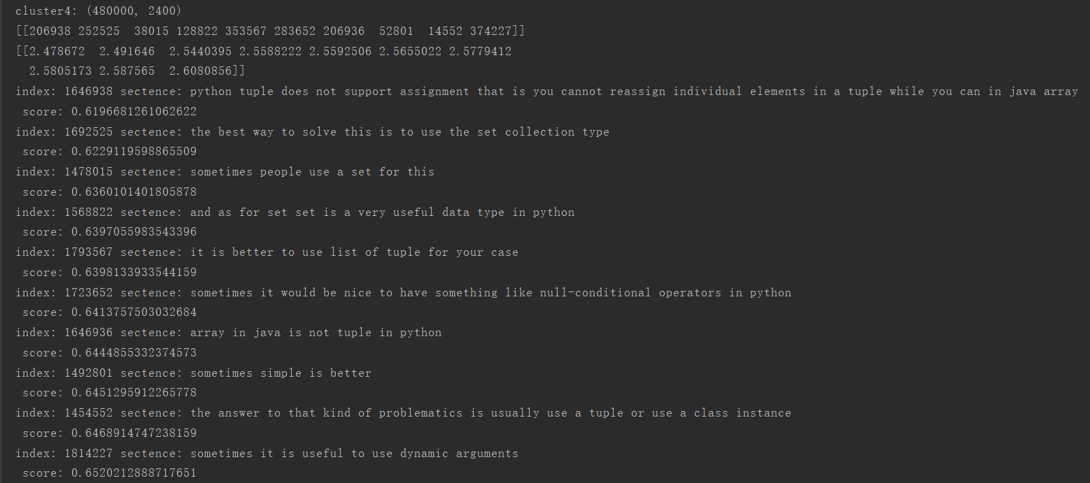
sometimes it will be better to use set tuple or dictionary list is the name given in python to dynamic arrays similar to from c++ or java
Notes:
采用不同的特征表达形式可以构造出不同的滤波组

Slide 49
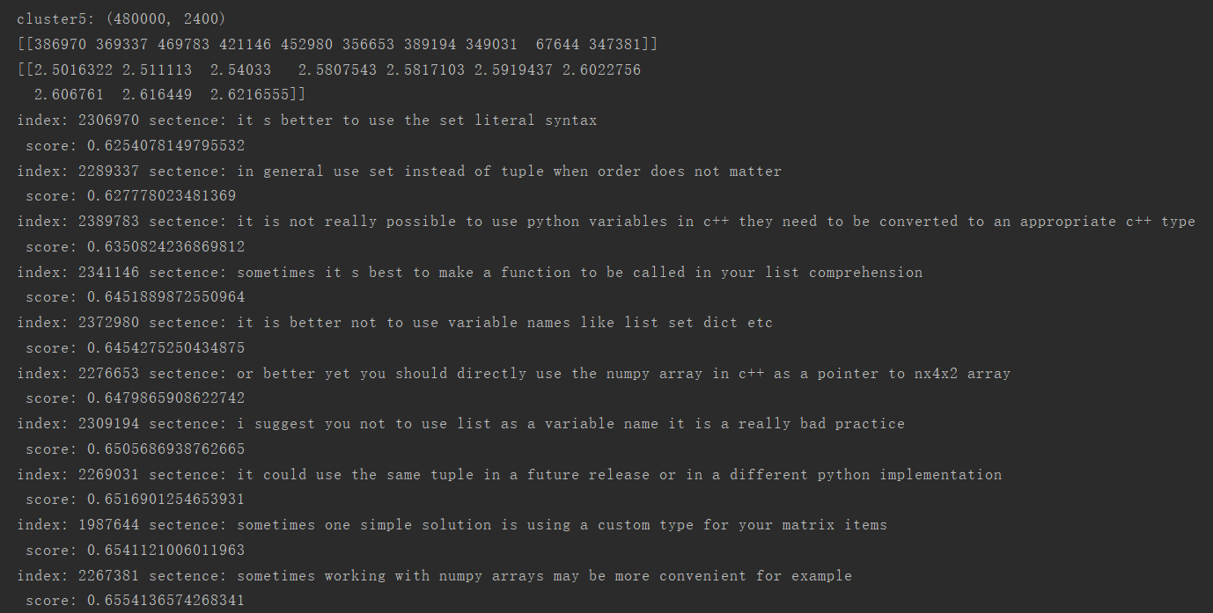
sometimes it will be better to use set tuple or dictionary list is the name given in python to dynamic arrays similar to from c++ or java
Notes:
采用不同的特征表达形式可以构造出不同的滤波组

Slide 50
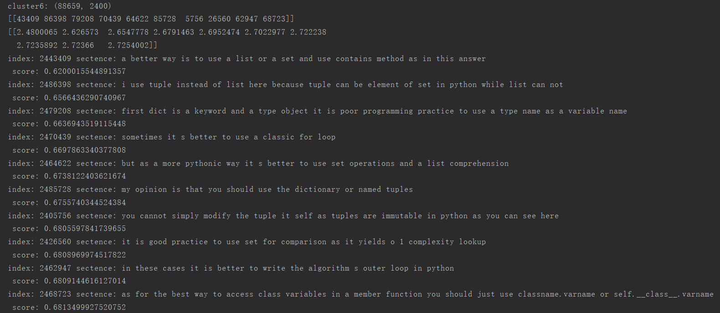
sometimes it will be better to use set tuple or dictionary list is the name given in python to dynamic arrays similar to from c++ or java
Notes:
采用不同的特征表达形式可以构造出不同的滤波组

Slide 51
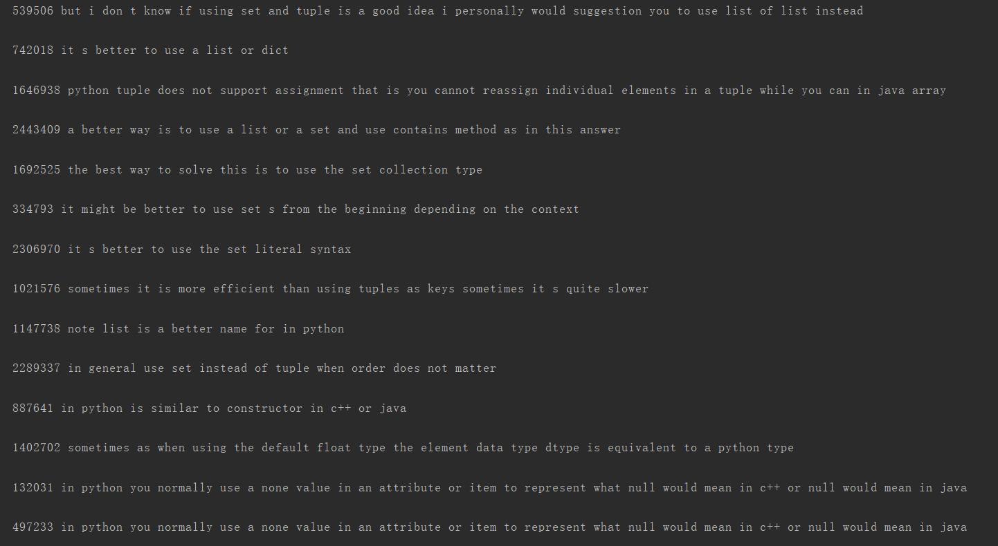
sometimes it will be better to use set tuple or dictionary list is the name given in python to dynamic arrays similar to from c++ or java
Notes:
采用不同的特征表达形式可以构造出不同的滤波组

Slide 52

python 3 receives new development and new features
Notes:
采用不同的特征表达形式可以构造出不同的滤波组

Slide 53

python 3 receives new development and new features
Notes:
采用不同的特征表达形式可以构造出不同的滤波组

Slide 54

python 3 receives new development and new features
Notes:
采用不同的特征表达形式可以构造出不同的滤波组

Slide 55

python 3 receives new development and new features
Notes:
采用不同的特征表达形式可以构造出不同的滤波组

Slide 56

python 3 receives new development and new features
Notes:
采用不同的特征表达形式可以构造出不同的滤波组

Slide 57

python 3 receives new development and new features
Notes:
采用不同的特征表达形式可以构造出不同的滤波组

Slide 58

python 3 receives new development and new features
Notes:
采用不同的特征表达形式可以构造出不同的滤波组

Slide 59
python 3 receives new development and new features
Notes:
采用不同的特征表达形式可以构造出不同的滤波组

Slide 60


Number of categories: 6
Category and Pattren
1.Definition：
2.Usage：
3.negative：pattren：don’t ;doesn’t ;is not; isn’t；cannot; aren’t; are not; never; hardly ;scarcely; nothing;nobody;neither; neither nor; none；
4.Warning： pattern: note; notice; warning; warn;
5.Similar： pattern :resemble ;similar ;appear;like ;seem ; as if; almost; similarity
6.comparative:pattern: most;more; than; the least；less；inferior ；superior
Total data volume：
127 277（examples）+4672（topics）
Word frequency ：

Slide 61


Keywords：example table and topics table

Slide 62
negative ：
30/426/3939
1 1117/ 127 277
Warn ：
177/3938
3472/ 127 277
Similar：
233/3938
1487/ 127 277
comparative ：
5699/127 277
71/3938

Slide 63
1. definition ：
1. Python is a widely used high-level programming language for general-purpose programming, created by Guido van Rossum and first released in 1991.
（tag：python topic：Getting started with Python Language example：Getting Started）
2. Python 2.x is the legacy version and will receive only security updates until 2020. （tag：python topic：Getting started with Python Language example：Getting Started）
3. pyglet is a python module used for visuals and sound.
（tag：python topic：Getting started with Python Language example：Getting Started）
4. a tuple is a immutable list of values.
（tag：python topic：Tuple）
a tuple is a comma-separated list of values
（tag：python topic：Tuple example：Tuple）
5. List comprehensions in Python are concise, syntactic constructs.
（tag：python topic： List）
6.mapping is any dictionary-like object with keys that match with the template placeholders. （tag：python topic：Templates in python example：Simple data output program using template）
7. decorator functions are software design patterns.
（tag：python topic：Decorators example：Decorator with arguments (decorator factory)）

Slide 64
2 .usage：
1.any function that takes a function as a parameter and returns an augmented function can be used as a decorator .（tag：ASP.NET topic：Getting started with ASP.NET example：Decorator function）
2.a list comprehension creates a new list by applying an expression to each element of an iterable. （tag：python topic：Performance optimization example：Code profiling）
3.in command line run there are multiple ways to close the python shell or alternatively ctrl + d will close the shell and `put you back on your terminal s command line.
（tag：python topic：Getting started with Python Language example：Getting Started）
4.finding the minimum maximum of a sequence of sequences is possible but if you want to sort by a specific element in each sequence use the key -argument.
(tag：python topic： Sorting, Minimum and Maximum example:Using the key argument ）
5. xrange exists only in later version of python 2.
6. in python 3 range just returns a generator.
（tag：python topic：List comprehensions example： Generator Expressions ）
7. in python variables inside functions are considered local if and only if they appear in the left side of an assignment statement or some other binding occurrence.
（tag：python topic：Variable Scope and Binding example： Global Variables）
8.class decorators only produce one instance for a specific function so decorating a method with a class decorator will share the same decorator between all instances of that class.
（tag：python topic：Decorators example： Decorator class）

Slide 65
3.注意事项 :警告：
1.note some ides like pycharm will issue a warning when a mutable type is specified as a default attribute.
（tag：python topic：Functions example：Defining a function with optional mutable arguments ）
2. note do not use pip to install ply, it will install a broken distribution on your machine.
（tag：python topic：Python Lex-Yacc example：Getting Started with PLY）
2.attempting to access an index outside the bounds of the list will raise an indexerror.
（tag：python topic：List example：Accessing list values)
4.note using from __future__ import print_function in python 2 will allow users to use the print function the same as python 3 code.
（tag：python topic：Basic Input and Output example：Using the print function)
5. note it s not recommended though to keep the signing credentials inside your gradle file.
（tag：android topic：RecyclerView onClickListeners example：a basic build.gradle file)
------pattern: note; warning; notice;warn;

Slide 66
4.否定意义：
1.generator objects cannot be indexed and makes use of the next function to get items in order.
（tag：python topic： Generators example: Introduction ）
2. limitations null-conditional operator produces rvalue not lvalue that is it cannot be used for property assignment event subscription.
（tag：C# topic： C# 6.0 Features example: Null propagation）
3.code in static context cannot reference code in instance context.
（tag：vba topic :Declaring Variables example: Variables ）
4. the size of the array cannot be specified as a long arrays use a zero-based index system which means indexing starts at 0 and ends at length – 1.
（tag：java topic:Arrays example: Creating and Initializing Arrays）
5.a point worth noting about the diamond is that it cannot be used with anonymous classes.
6. The diamond does not behave as an operator, and is not described or listed anywhere in the JLS or the (official) Java Tutorials as an operator.
（tag：java topic：Generics Features example: The Diamond）
Pattren：don’t ;doesn’t ;is not; isn’t ;cannot; aren’t; are not; never;hardly,;scarcely, nothing;nobody;neither; neither nor; none

Slide 67
5.similar
1.generator expressions are very similar to list comprehensions.
（tag：python topic：List comprehensions example：Generator Expressions）
2. getting the minimum of a sequence iterable is equivalent of accessing the first element of a sorted sequence the maximum is a bit more complicated because sorted keeps order and max returns the first encountered value.
（tag：python topic：Sorting, Minimum and Maximum example： Minimum and Maximum of a sequence ）
3.set comprehension is similar to list and dictionary comprehension but it produces a set which is an unordered collection of unique elements.
（tag：python topic： List comprehensions example： Set Comprehensions ）
4.similarly a function with a return statement but no return value or variable returns none. Returning values from functions.
（tag：python topic： Functions example： Returning values from functions ）
5.the cmath module is extremely similar to the math module except for the fact it can compute complex numbers and all of its results are in the form of a + bi.
（tag：python topic：Exponentiation example： Square root: math.sqrt() and cmath.sqrt ）
Pattren: resemble ;similar ;appear;like ;seem ; as if; almost

Slide 68
6. comparative
1.the map function is the simplest one among python built-ins used for functional programming.
（tag：python topic： Map Function example： Basic use of map, itertools.imap and future_builtins.map ）
2. with unix systems and version earlier than 3.3 the processes are created using a fork.
3. forkserver and spawn methods are slower than forking but avoid some unexpected behaviors. The multiprocessing module
（tag：python topic： Python concurrency example： The multiprocessing module ）
4. unfortunately the major down-side of asymmetric encryption algorithms is that they are significantly slower than their symmetric cousins.
（tag：python topic： Cryptography (System.Security.Cryptography) example： Fast Asymmetric File Encryption ）
5.however if you need to use the values produced by a generator more than once and if generating them costs more than storing it may be better to store the yielded values as a list than to re-generate the sequence.（tag：python topic： Generators example： Introduction）
---------pattern: most;more; than; the least；less；inferior ；superior

Slide 69
Q&A

Slide 70
question
1. Python lists are zero-indexed, and act like arrays in other languages.usage
（tag：python topic： Type Parameterization (Generics) example： Accessing list values）
2 .This exception is raised when the indentation level increases with no reason.
（tag：python topic： Commonwealth Exceptions example：IndentationErrors (or indentation SyntaxErrors)）usage
3..be sure to check beforehand that there is such an argument or a keyerror will be raised.
（tag：python topic：Functions example：Defining a function with an arbitrary number of arguments)
4. most exceptions are not handled by programs. usage.
5.the most common type of unsupervised learning is cluster analysis or clustering。
6. most exceptions are not handled by programs.
（tag：python topic： Exceptions ）
7. python variables do not need an explicit declaration to reserve memory space.
（tag：python topic： Incompatibilities moving from Python 2 to Python 3 example : Absolute/Relative Imports）
8.creation of the documentation the documentation for your code has to be in a format which is very similar to latex.

Slide 71
different
a part of wordpress that makes it different from most other cms products is its event driven programming.
2. the mechanics are different in python 2 vs python 3 but the concept is the same in that you can take the output that would have gone to the screen and send it to a file instead.
3.generally both type and value need to match so the int 12 is not the same as the string 12.
4. comparing dates using a localdate is different from using chronolocaldate because the chronology or calendar system are not taken in account the first one
Pattren: different;unlike;Distinct ;distinct;not like;not the same; differ；difference；Discrepancy；disparity；Inconformity；discord；Inconsistent;

